Slide 1
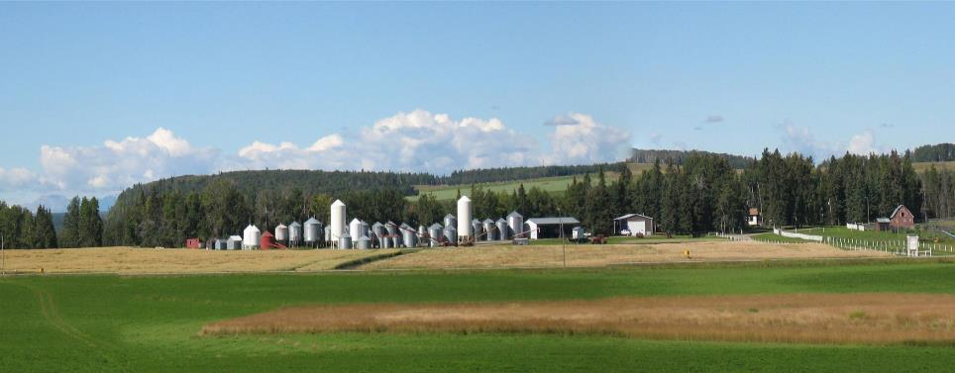
MASTIN SEEDS
MASTIN种业
Sundre, Alberta
阿尔伯塔省
Sundre镇
Notes:
Hello, I am Bob Mastin Owner of Mastin Seeds. We are located along the Red Deer River near Sundre, Alberta at the very western edge of the Canadian Prairies. I want to thank you for the opportunity to introduce myself today.
你好，我是Bob Mastin， Mastin种业的拥有者。我们位于沿着红鹿河附近阿尔伯塔省Sundre镇。是加拿大大草原的最西端。感谢今天有机会给大家介绍我的家乡和农场。

Slide 2
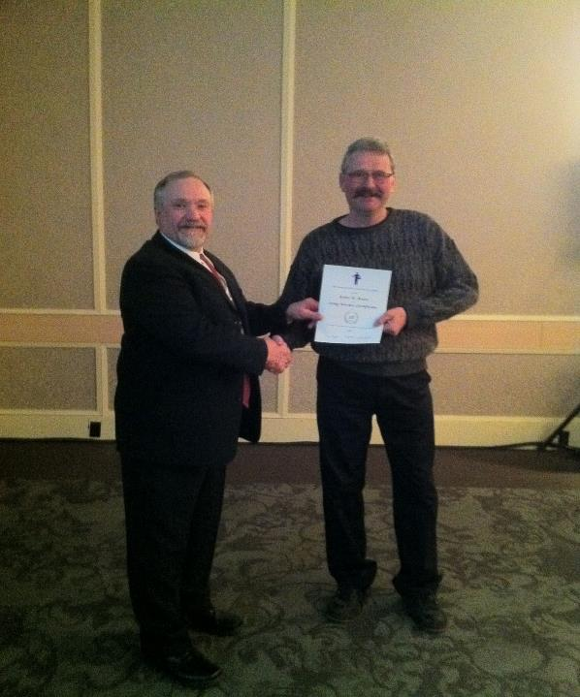
Top Quality Seed
Producer for 35 Years
-连续 35年优质种子生产从业奖
Notes:
For many years Mastin Seeds has been a very typical Canadian producer and retailer of quality Pedigreed seed, with a focus on feed and forage varieties. Here, I am receiving a 35 year award in January of 2013.
多年来，Mastin种业作为一个非常典型的加拿大高质量原种种子生产商和零售商，致力于饲料牧草品种。本图片是我于2013年1月份我得到35年优质种子生产从业奖。

Slide 3
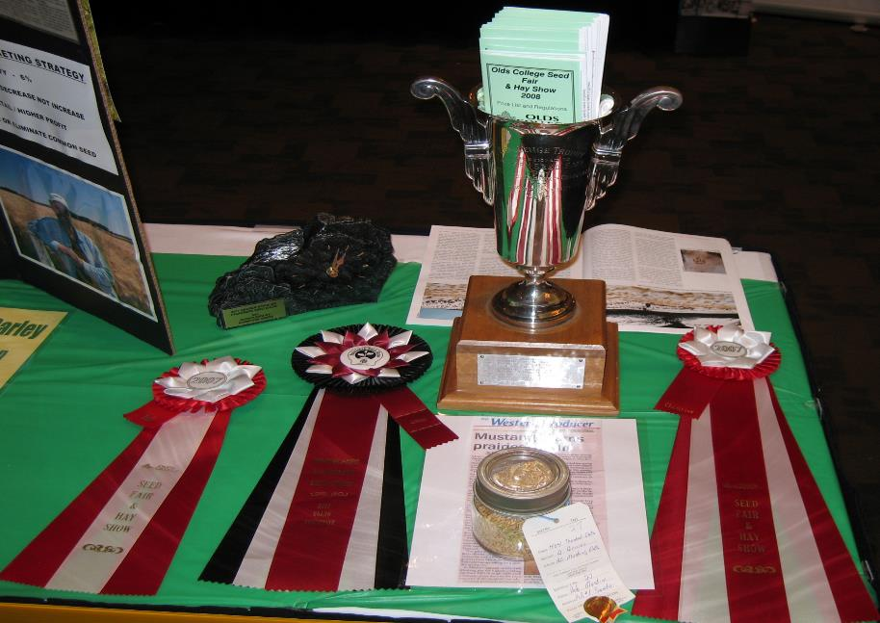
A few of many seed awards - 奖项代表
Notes:
Our success at unprecedented quality is partly due to our attention to detail during production and our unique non-traditional location. Mastin Seeds has won numerous awards at almost every seed show in Western Canada. The ribbons and awards shown here are about 1% of the awards we have received.
-我们生产的高质量种子一部分原因是由于我们在生产过程中对细节的关注和我们独特的地理位置。Mastin种业赢得了无数的奖项，几乎囊括所有加拿大西部种子展览奖。这里展示的只是我们得到奖项1％左右。

Slide 4
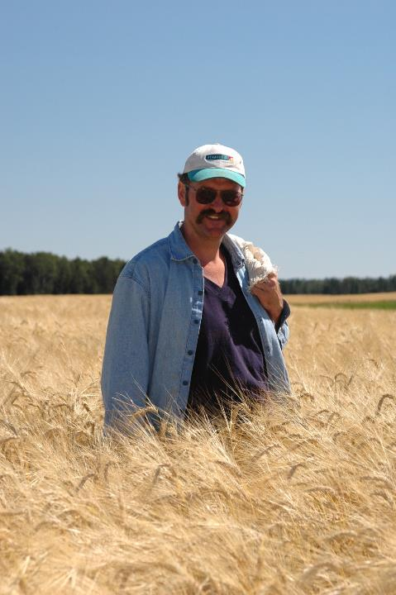
Hand picking (roguing)
a seed field
-在种子地里手工摘取
(筛选)
Notes:
We inspect every field on foot and hand pick anything that shouldn’t be there.
Here I am in a Sundre Barley field with a sack draped over my left shoulder to hold off types.
- 耕种季节，我们会走入田间，仔细排查，用手摘取任何杂草。 此图片是是我在Sundre大麦田所照，左肩搭一条装杂草的麻袋。

Slide 5
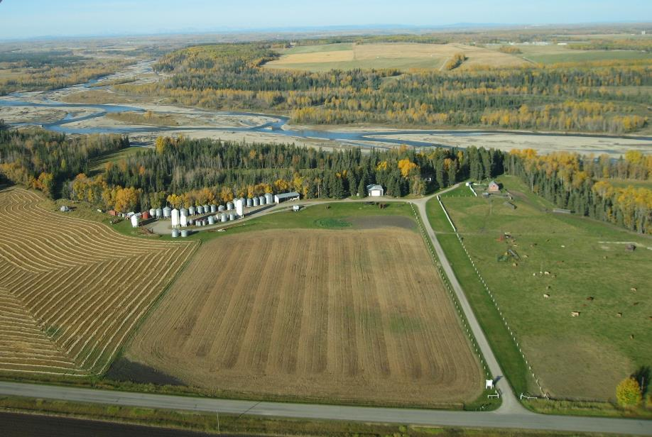
Mastin Seeds’ unique location helps maintain purity
- “Mastin 种业”独特的地理位置有利于控制种子的纯净度
Notes:
Our unique location also helps us maintain purity, as we are surrounded by trees, a river, pasture and hay land.
In this aerial view of my farm you can see the Red Deer River forming my western boundary with a lot of trees and a few fields, slowly becoming mostly trees as you travel west to the Rocky Mountains.
- 我们独特的地理位置可以帮助我们保持种子的纯净，农场周边是树木，河流，牧场和干草地。
- 从空中俯瞰农场的西边界，你可以看到红鹿河以西有很多树和一些田地，直到西部旅行圣地的落基山脉森林。

Slide 6
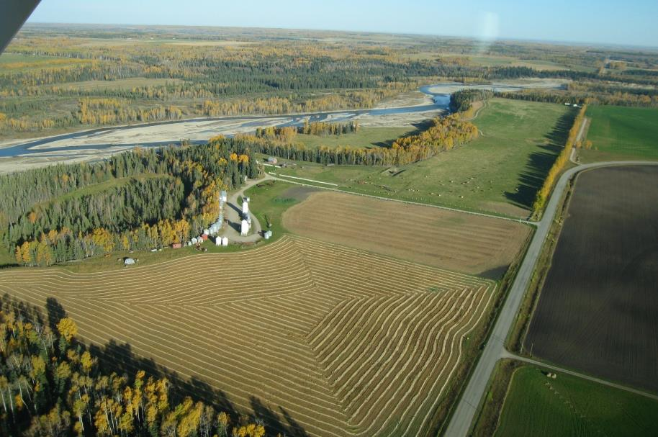
Mastin Seeds is isolated by a river, trees, and pasture
- Mastin 种业农场是被河流，树木和牧场包裹着的
Notes:
This view shows the sharp contrast as you cross the river going west, to the rich farmland shown on the right.
- 该视图显示了鲜明的对比，您渡河往西，在右边显示的是肥沃的农田。

Slide 7
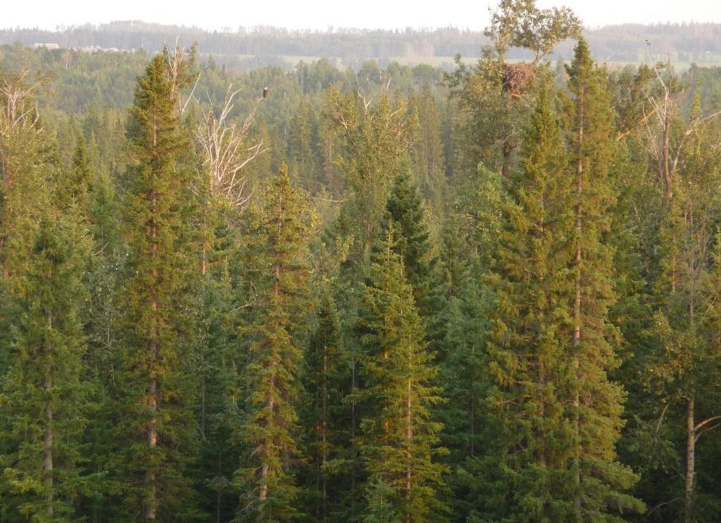
Eagles nest with Eagle -鹰和他的鹰巢
Notes:
Because my location is so unique, I’m going to take a little time to show you some of the beauty of the area. Here, just a few hundred meters west across the river from my farm is a very large Eagle’s nest shown with the Eagle about 20meters to the left
- 因为我们的位置是独一无二的，我会花一点时间向您展示一些地区的美景。从我的农厂看去，河流西部几百米的对面有一个很大的鹰槽，在左20米向可以看到一只鹰。

Slide 8
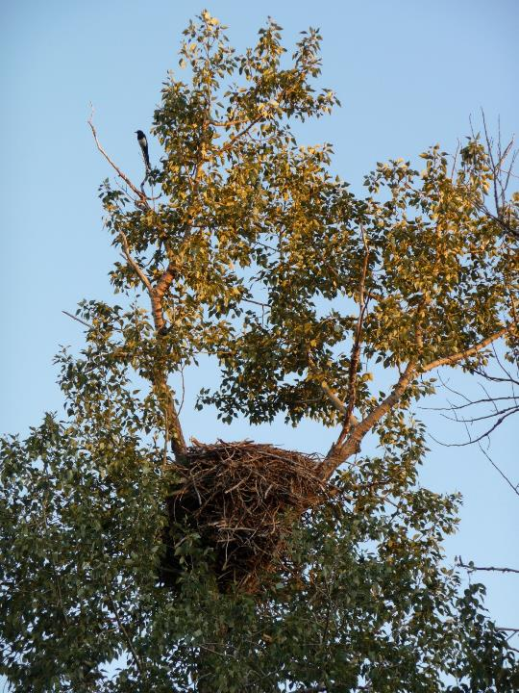
Close up of Eagles nest
- 鹰巢的近景
The wilderness is home to Black Bears, Cougars, Elk, Deer, Moose, Beaver, and Wolves
-这里野生动物黑熊，美洲狮，梅花鹿，驼鹿 ，海狸和狼的家
Notes:
And a close up of the nest, surrounded by wilderness that is home to not only these Eagles, but Black Bears, Cougars, Elk, Deer, Moose, Beaver and Wolves just to mention a few of the animals that I have seen.
- 鹰巢的近景。这周边是野生的黑熊，美洲狮，梅花鹿，驼鹿 ，海狸和狼的家，都是我亲眼见过的动物。

Slide 9
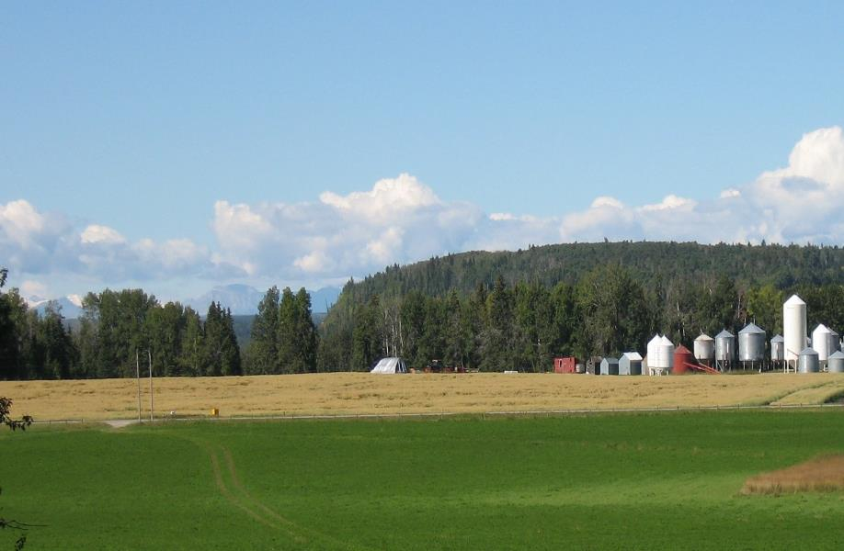
Rocky Mountains and Banff in the distance
- 这里离落基山脉和班芙镇都不远-（离电影断背山取景地很近）
Notes:
Returning to my farm and looking SW you can see the Rocky Mountains in the distance. This is where the Red Deer River leaves Banff National Park, and 50 km to the SW of these mountains is the town of Banff, headquarters for Canada’s first and most famous National Park.
- 回到我的农场，向西南看，你可以看到落基山脉。这条红鹿河是从班芙国家公园流过来的，在山脉西南50公里的地方是班芙镇，这是加拿大最著名的国家公园镇。

Slide 10
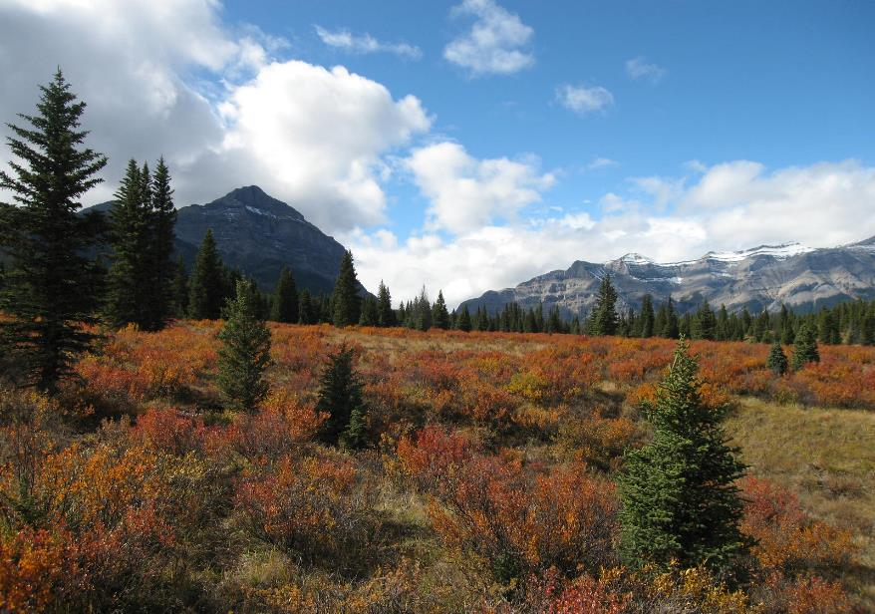
Eastern Boundary of Banff National Park
- 坐落在班芙国家公园的东侧边境线外
Notes:
This is a closer view of the gap in the mountains where the Red Deer river leaves Banff National Park, I have been fortunate to do some horseback riding in the area.
- 这里你可以看到红鹿河在大山的夹缝中流出，远离班芙国家公园。我也很幸运地可以骑着马在这逛逛。

Slide 11
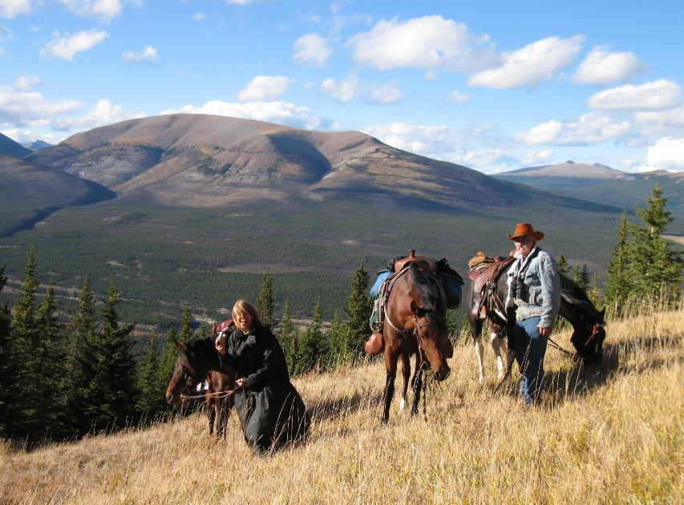
Riding with neighbors – 一起骑马的邻居
Notes:
Here with neighbors.
这是我们的附近地区的景色

Slide 12
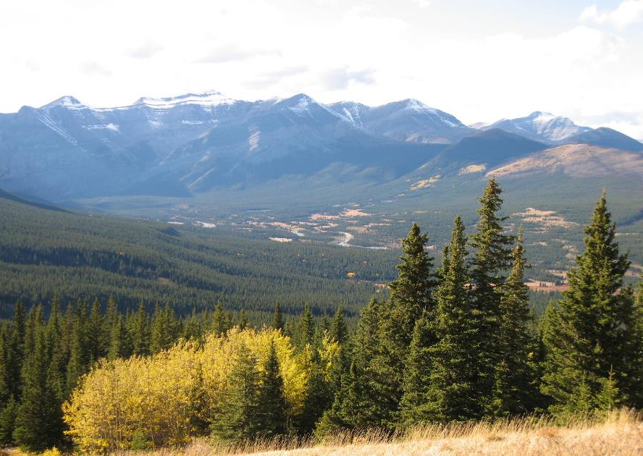
Red Deer River Valley - 这是红鹿河谷
Notes:
This was our view to the left, looking up the Red Deer River Valley.
- 在我们视野的左面，可以看到红鹿河谷。

Slide 13
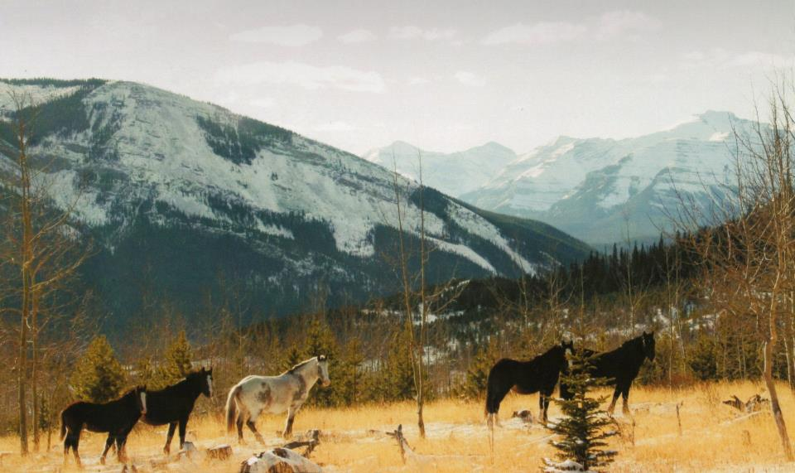
Sundre’s Wild Horses – 我家乡Sundre的野马
Notes:
Now if we head back downstream towards my farm, travelling past this herd of wild horses along the way, I will go into a little more detail about my business.
- 现在，我们掉转马头下山，穿过这批野马群，就到了我的农场。接下来我介绍一下我的Mastin 种业。

Slide 14
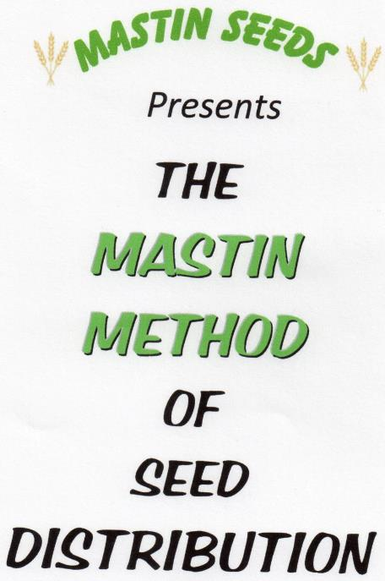
Mastin Method
- Mastin 方式方法
Designed to Increase
Pedigreed Seed Usage
- 提高纯正种子的有效传播
Notes:
In 2006, after nearly 30 years as a traditional seed grower and retailer, I began looking for other seed related ventures that could be used to diversify my business. I entered the world of seed distribution with my successful bid for a great new Barley variety, using some fresh and innovative ideas that have evolved into what I call The Mastin Method Of Seed Distribution.
The cornerstone of my distribution philosophy is to increase the use of high quality pedigreed seed by Canadian Farmers. Right now pedigreed seed use is fairly low in Western Canada. If farmers were to use higher quality seeds they would be more productive and produce an even higher quality product. They produce a high quality product now, but I can help them make it even better.
The quickest and easiest advancement for Agriculture in Western Canada could simply be the increased use of pedigreed seed and I am trying to assist in that happening.
经过近30年的传统种子种植和零售后，2006年我开始寻找其他与种子相关项目来扩大我的生意范围。功夫不负有心人，当年我成功中标了一项大麦新品种，从此进入了全球种子销售领域。通过多年经验总结，我成功推出Mastin 种业方法论。
我的生产理念的基石是鼓励加拿大农民增加使用高品质原种。现在在加拿大西部原种使用率是相当低的。如果农民使用优质原种，我敢确认他们会在已有基础上，大幅度增加优质草的产量。在加拿大西部推进农业进步最直接快捷的方法就是大面积使用原种，我正在协助这项使命的开展。

Slide 15
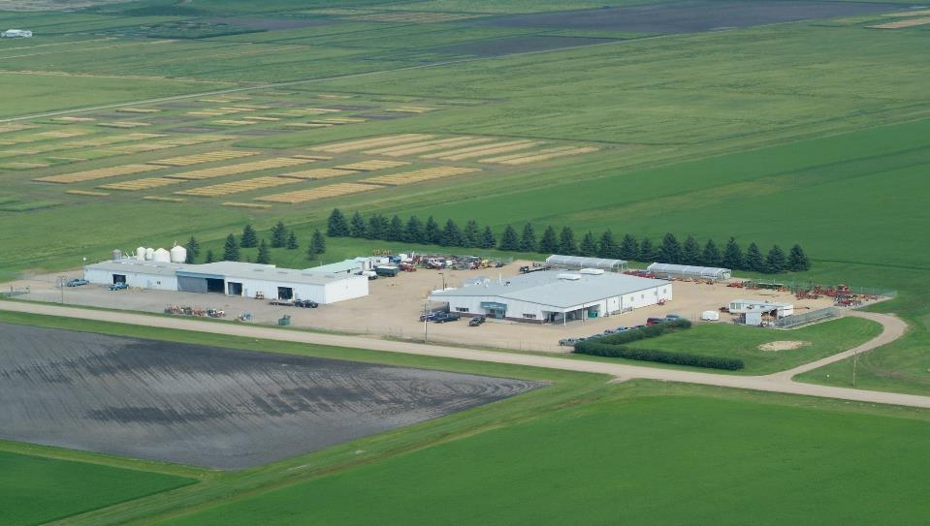
Field Crop Development Centre. Lacombe, Alberta
加拿大农业研发中心 - 阿尔伯塔省Lacombe镇
Breeder Distributor Seed Grower Farmer Customer 5 to 10 years 饲养员 分销商 种子种植者 农场主 客户 5 - 10 年
Notes:
To give a very quick and general overview of the Canadian Grain Industry as far as new variety development goes, we have research scientists and plant breeders working at centers like this world class facility to create new and better varieties of almost every crop type grown in Canada.
If they are successful at passing many stringent requirements and create a new superior variety, they offer it for bid to distributors that will promote and market the variety.
Much of the distributor’s promotions and marketing is to seed growers and retailers, who in turn promote and market the variety to Canadian Farmers.
If it is a superior variety that is well marketed, it could be grown in vast amounts and possibly exported around the world to end users such as yourselves.
Being a seed distributor, a grower and retailer I take the seed from the plant breeders at the research centers, through all the channels down to the end users.
Often, I only receive a few kilograms of seed and spend several years multiplying seed stocks. Once I have enough seed to supply the seed producers, they spend at least one year multiplying supplies to meet retail demand.
The time from when I receive the precious new seed to when the variety is widely grown by farmers is often 5 to 10 years, which is when it would be available to end users like yourselves for the first time.
有关对新种培育的情况，我很高兴给大家做个简要介绍。这张图片展示的是加拿大农业研发中心。这里拥有世界先进水平的设施，可进行全方位种子培育工作，拥有大量科研人员和育种专家。它研究推广的品种几乎涉及到在加拿大所生长的每一种作物类型。
一个新优良品种的诞生需要经过极其严格的审核。然后，它会被投放到市场竞价。
成功的种子经销商把这个品种推销到种子种植者和零售商，最终推广到加拿大农民手中，大批生产。
如果它确实是一个优良品种，市场推广得好，它就可以得到大面积生产，更可能出口到世界各地的用户， 比如三宝。
作为一名原种的生产和经销者，我会直接从研发中心得到新品种，通过我的渠道，推广到最终用户
通常情况下，我只收到几公斤种子，花数年培育和种植，以增加其储备。当我有足够的种子供应给种子生产商时，他们同样要花费至少一年时间的培育，以满足零售的需求。
整个过程，从我拿到最新种子开始到种子得到其大量生产，往往需要5-10年的期限。

Slide 16
Mastin Seeds Grows and Retails Seed
Plus
Distributes 14 Varieties
Mastin种业生产和零售的14种不同的种子
2 Field Peas – 2 种豌豆
1 Spring Wheat – 1种春小麦
1 Winter Wheat– 1种冬小麦
2 Canola – 2种油菜仔
2 Triticale – 2种黑小麦
3 Oats – 3种燕麦
3 Barley – 3种大麦
Notes:
I will now briefly describe the crop types I distribute.
-现在我简要介绍我出售的作物种类。

Slide 17
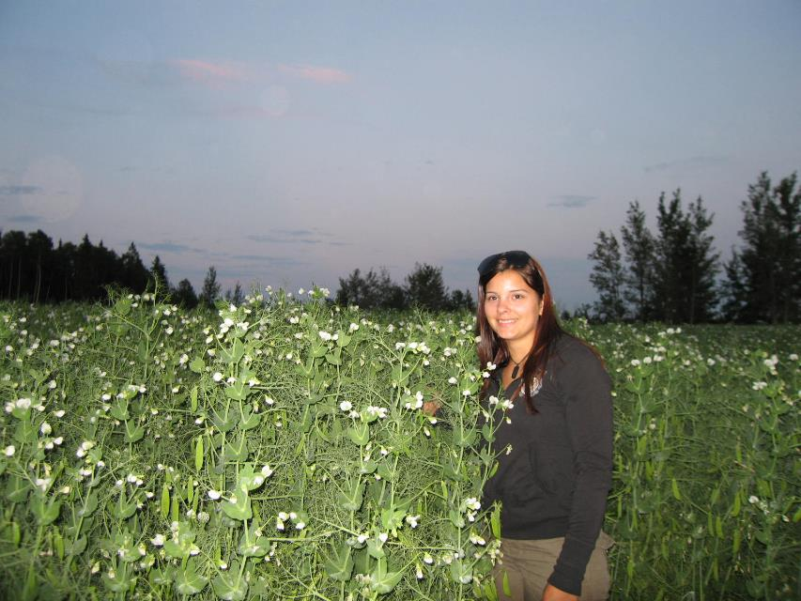
Forage Peas - 饲料豌豆
Notes:
I have a Forage Pea that can stand as tall as me. It is an excellent mix with barley or oats for forage production.
I also have a new blocky green pea called Tetris that was developed for the snack food market here in Asia.
我种植的饲料豌豆，可以长得跟人一样高。这是一个绝佳的品种，可以与大麦或燕麦搭配作为混合饲料。
我也有一个新的的斑驳绿色豌豆称为俄罗斯方块，这个品种主要销往亚洲，作为休闲食品。

Slide 18
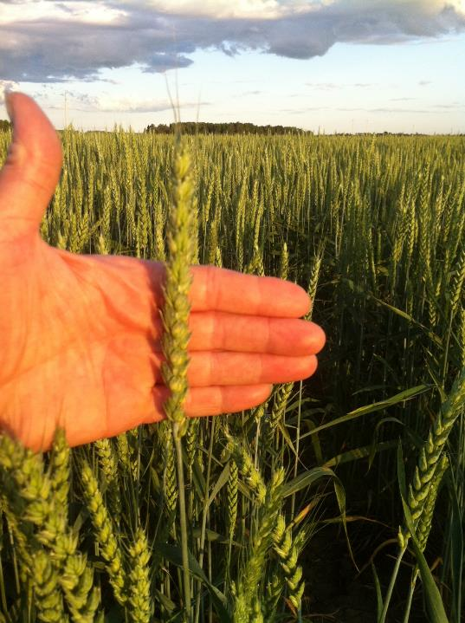
Winter Wheat
- 冬小麦
Notes:
I have a spring and winter wheat, with the winter wheat holding the most potential for success.
If we can develop winter cereals that can survive and thrive in Western Canada that would be a huge advancement for Canadian Agriculture.
- 我种植春小麦和冬小麦。冬小麦目前已展现了成功的潜力。
- 如果我们能够做到将冬季谷物在加拿大西部生存和茁壮成长，这将是加拿大农业的一个巨大进步。

Slide 19
Mastin Seeds Grows and Retails Seed
Plus
Distributes 14 Varieties
Mastin种业生产和零售，代理的14品种
2 Field Peas – 2 种豌豆
1 Spring Wheat – 2种春小麦
1 Winter Wheat– 1种冬小麦
2 Canola – 2种油菜仔
2 Triticale – 2种黑小麦
3 Oats – 1种燕麦
3 Barley – 1种大麦
Notes:
I also have two early maturing canola varieties, that mature anywhere from two weeks to one month earlier than the canola now being grown in Canada.
As well, I have a spring and winter triticale, but this is currently a very small and specialized market.
我也有两个早熟油菜品种，它的成熟期要比其它传统油菜籽早两个星期至一个月。
同时，我有一个春季和冬季黑麦，但数量小，仅供专门市场。

Slide 20
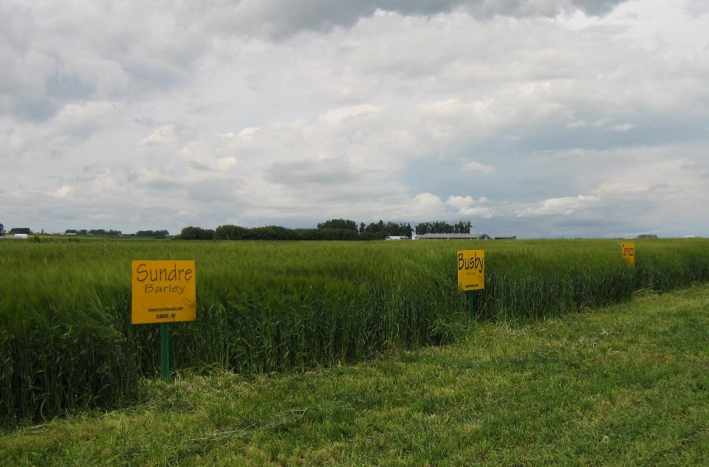
Sundre
Busby
Cerveza
Notes:
I’ll now talk about my barley varieties Sundre, Busby and Cerveza in a little more detail.
Earlier I mentioned that I became a seed distributor when I was the successful bidder for the best barley I had ever seen.
- 现在我来谈谈我的大麦品种Sundre ，Busby和Cerveza。
- 刚才我提到了我是如何成为一个种子经销商的。就是我成功中标的这个品种Sundre，他是我曾见过的最好的大麦品种。

Slide 21
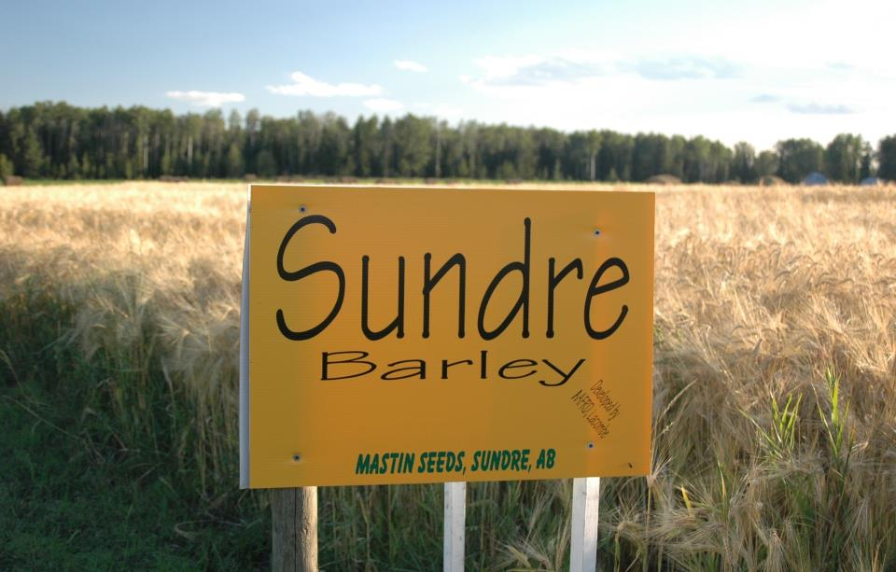
Sundre Barley
# 1 Six Row
Multi-purpose
Good Agronomics
Potential for tea
Notes:
That Barley was named Sundre, after my home town, and has become the most popular six row barley in Canada.
It has many desirable characteristics, such as being excellent for both grain and forage production. It has good agronomic characteristics, such as disease resistance, drought tolerance, smooth awns, an aggressive and hardy growth pattern, to name just a few. Not only does it have all of these desirable characteristics for producers in Canada, it appears to have many of the desirable qualities needed to make barley tea, which may be of interest to you.
Seed distribution was a whole new venture for me, and it has gone better than I could have imagined.
I thank Sundre barley for a lot of my success.
这个大麦用我的家乡命名Sundre ，并已经成为在加拿大最流行的六款大麦之一。
Sundre 大麦可用于经济作物和饲料，它具有许多优良特性，它的农业性征，比如抗病，耐旱，积极和顽强的增长模式。它不仅拥有所有其它大麦的全部特性，还可能是做大麦茶的理想原料。也许您对这点感兴趣。
当时对我来说种子销售是一个全新的企业机遇，它的发展已远远高于我的期待。
我感谢Sundre大麦了带给我的成功。

Slide 22
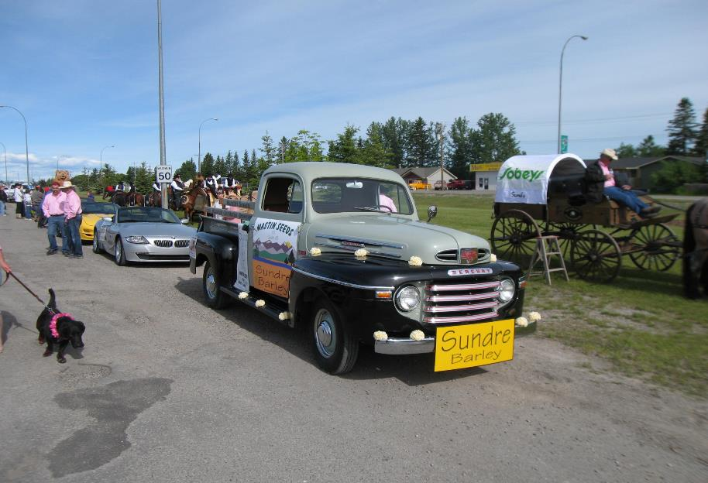
Ready to lead the parade – 准备好去带领游行队伍
Notes:
This one barley has done more for me than I could have imagined. For example, the town of Sundre did a salute to Agriculture in 2011 and asked me to be their parade marshal.
Numerous newspapers and media of all types, including television, have done stories on the success of Sundre barley.
I’ve had a lot of fun promoting this barley.
还值得提及的是2011年农业部在Sundre镇做了一个产品展示游行，我的Sundre大麦成为他们的领跑旗舰。
很多报纸和电视媒体，都对Sundre大麦的成功做了报道。
我也乐在其中

Slide 23
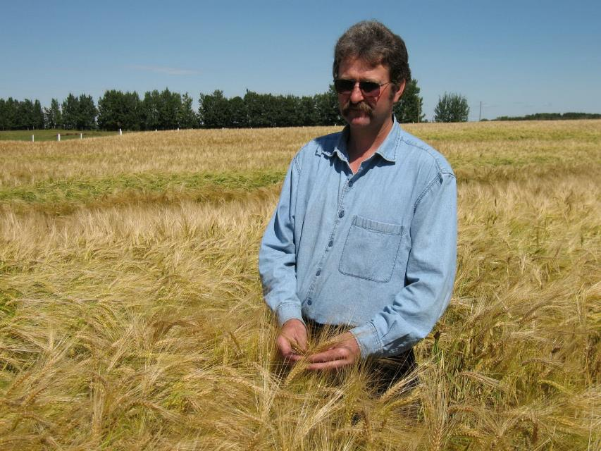
Busby Barley - Busby 大麦
Notes:
The next barley I will briefly describe is a two row general purpose barley, also bred at the Field Crop Development Center In Lacombe Alberta, which they named Busby after the town of Busby. As you may have noticed many barleys developed in Alberta are named after Alberta towns.
Busby is high yielding with big plump kernels and a high test weight.
Its most notable attribute is its disease resistance, which is the best of any two row barley.
It also is an excellent dual purpose barley with high forage yields. Because Alberta has such a large livestock industry, many of the varieties developed in Alberta are also excellent forage varieties.
接下来我要介绍的是所谓的双行普通大麦，它也是研发中心培植的，以另外一个当地村镇·命名 – Busby
- Busby以高产著称，内核饱满 所以重量也偏高。 其最显著的特性是它的抗病性，在双行大麦中领先。
- Busby 也是一个良好的具有双重用途的大麦。因为它的高产性，据畜牧草首选。顺便提及的是，由于阿尔伯塔省畜牧产业很大，许多在艾伯塔省开发的品种也都是优秀的牧草品种。

Slide 24
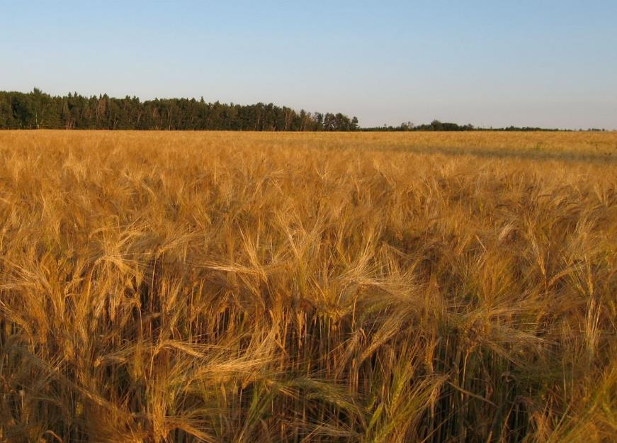
Cerveza Barley – Cerveza 大麦
Notes:
My third variety is an exciting 2 row malt barley developed by Agriculture Canada at the same location and by the same plant breeder that developed AC Metcalfe, the most popular malt variety in Canada.
I was able to name it Cerveza which means beer in Spanish.
It is the highest yielding malt barley in Canada and has a high malt extract. It is ideally suited to the craft brewing industry and several brewers have expressed interest.
我的第三种双行大麦也是在加拿大研发中心开发的，它是加拿大最流行的麦芽。
- 我以西班牙语Cerveza命名它 – 中文含义是“啤酒“。
- Cerveza是加拿大最高产的啤酒大麦，具有较高的麦芽汁。它非常适合于啤酒酿造工艺需要，一些酿酒商都表示对此很有兴趣。

Slide 25
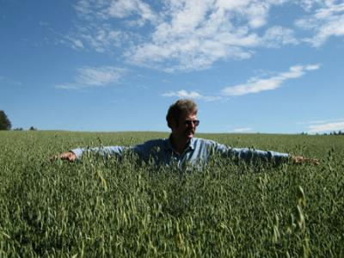
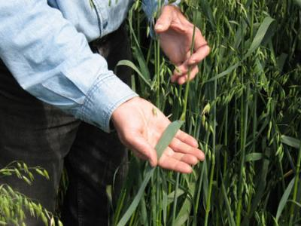
AC Mustang Oats - AC 野马燕麦
Notes:
In 1996 I became the largest grower and retailer of oats in Alberta.
I have 3 oat varieties, the most popular is an excellent dual purpose oat, called AC Mustang. It has large plump kernels and big wide leaves making it excellent for both grain and forage production. It works well by itself or in various mixes.
- 从1996年起，我成为阿尔伯塔燕麦最大的种植主和零售商。
- 我有3个燕麦品种，最流行的是一个优秀的两用燕麦，称为AC野马燕麦。内核饱满，宽叶肥大使它成为优秀的谷物和饲料双重功能产品。它可以单独使用，也可和其它品种混合使用，效果都很好。

Slide 26
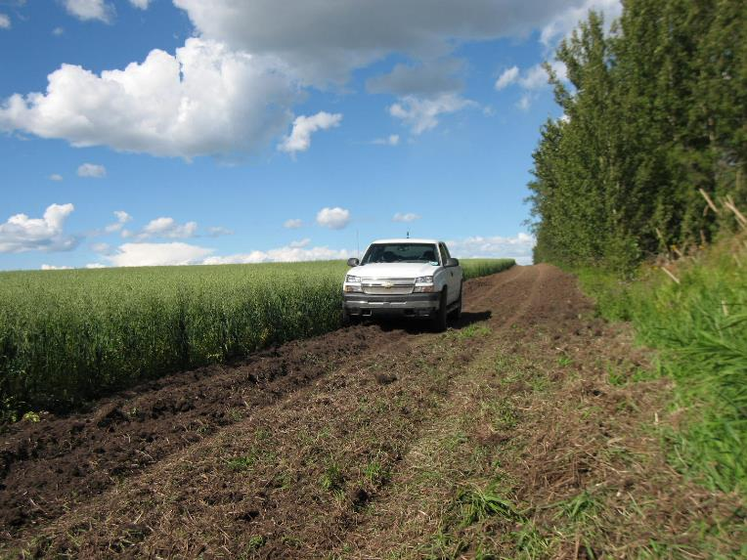
Derby Oats – Derby 燕麦
Notes:
I also have a milling oat, called Derby. For many years it was the most popular milling oat in Canada both in acres grown and acceptance by millers. It has been replaced by newer varieties but still has some unsurpassable features making it now a niche market specialty oat.
我也有一个制粉燕麦，叫Derby。多年来，这是在加拿大最流行的制粉燕麦，可以在大田种植，并广泛被面粉厂接受。在很多情况下它已被新品种取代，但仍然有一些无法超越的特性作为特殊品种存在。

Slide 27
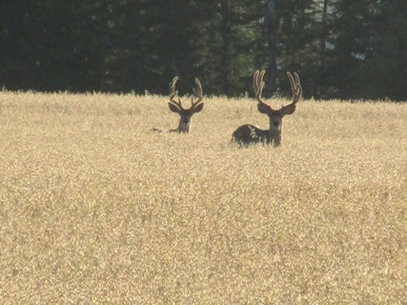
Juniper Oats – Juniper 燕麦
Notes:
Juniper is an early maturing high quality feed oat with good lodging resistance. It also works well for forage with a fine soft stem that is very palatable.
- Juniper燕麦是一个早熟优质饲料燕麦具有很好的抗倒伏能力。它的口感松软干燥，也是一种理想饲料。

Slide 28
MASTIN SEEDS
- MASTIN 种业
Sundre, Alberta
阿尔伯塔省Sundre镇
Notes:
I am a small company that is deeply committed to improving the seed industry and by extension all agriculture in Canada and around the world.
- 我虽然是大森林里的一颗小树，但我的目标是致力于加拿大，乃至全球市场，对提升种业的发展做出我的努力和贡献。

Slide 29
China & Canada may seem like they are long way apart, but as I watch the sunset over the Canadian Rocky Mountains, I am also watching the same sun rise over China（This is a picture of a sunset from my backyard）
中国与加拿大看似遥远，但当我看着夕阳西下于落基山脉时，我仿佛看到同一轮红日升起在中国的大地上。
（本照片摄于我的住宅后院）
Notes:
In closing, a final point I’d like to make, is that, because of our climate, Alberta is one of the best places in the world to safely grow and then store grain for long periods of time, an important consideration to ensuring a secure supply.
This brings me to the end of my very brief presentation. I want to thank you for your interest and really appreciate the opportunity to meet with you and learn. The more I understand about your needs, the better I will be able to assist you in meeting them.
Thank you！
最后，我愿意跟大家分享的是，由于我们拥有特殊的气候和环境，阿尔伯塔省是世界上最好，最安全的种植地之一，而且可以长期储藏麦草，确保供应。
我的简短介绍就到此结束。非常感谢您的关注，并非常高兴能有这个机会与大家见面。希望通过了解，得知贵公司的需求，从而提供更好的帮助！
谢谢！

